Slide 1
LIBRARY MANAGEMENT SYSTEM
Week 3 – 5(Elaboration(iteration 1))
Core Architecture & Requirements

Slide 2
30% USE CASES
USE CASES
Remove book
Add book
Borrow book
Return a book
Add member

Slide 3
Detailed Use Cases Add a book
Actor: Librarian
Description: A librarian adds a new book
Preconditions: the book must not exist in the system
Postconditions: the new book is successfully added to the library catalog and is available for burrowing and viewing
Main flow: librarian navigates to add book section
Librarian enters book details in a form
Librarian submits the form
The system adds the book record to the database and confirms

Slide 4
Detailed Use Cases Remove a book
Actor: Librarian
Description: A librarian removes a book
Preconditions: the book must exist in the system
Postconditions: the book is successfully removed from the library catalog and is no longer available for burrowing or viewing
Main flow: librarian navigates to remove book section
Librarian enters book details in a form
Librarian submits the form
The system removes the book record from the database and confirms
Alternative flows:

Slide 5
Detailed Use Cases Borrow a book
Actors: Member, system
Preconditions: the member must be logged into the system. And the book is available to be borrowed
Trigger: A member wants to borrow a book.
Main Flow: the member searches for the required book in the system
System displays book details, including availability status
The member selects the option to borrow the book
The system checks if the book is available.
If available, the system assigns the book to the member and records the borrowing transaction.
System updates the books availability status to borrowed.
Alternate flow: book not available: if the book is already borrowed or reserved the system notifies the member.
Burrowing limit reached: if the number has reached the maximum number of burrowed books allowed, the system prevents burrowing books, the system prevents the burrowing action
Post conditions: The book is assigned to the member and marked as "borrowed" in the system.

Slide 6
Detailed Use Cases Return a book
Actors: Member, system
Preconditions: the member must be logged into the system. And the book is available to be borrowed
The book must be currently borrowed by the member.
TriggerA member wants to return a borrowed book.
Main Flow: The member navigates to the "Return Book" section.
The system displays a list of books borrowed by the member.
The member selects the book to return.
The system records the return date.
The system calculates any overdue fines (if applicable).If a fine exists, the system notifies the member. The system updates the book’s availability status to "available”.
The system confirms the successful return of the book.

Slide 7
Cont…
Alternate flow: book not available: if the book is already borrowed or reserved the system notifies the member.
Postcondition(s):The book is marked as "available.“
Any applicable fine is recorded
Exceptions: If the system fails to update the return record, an error message is displayed, and the return process is halted.

Slide 8
Add a member
Actors: User
Description: This use case describes the process by which a visitor registers as a member in the library management system to gain access to library services such as borrowing books, accessing digital resources, and viewing account information.
Preconditions: The user is not already registered in the system.
The system is up and running.

Slide 9
Cont…
Postconditions: A new member account is created and stored in the system. The user is assigned a unique membership ID.
Main Flow: The visitor navigates to the library registration page.
The system displays the registration form.
The visitor fills in required information (e.g., name, email, phone number, address, password).
The visitor submits the registration form.
The system validates the input data.
The system creates a new member record in the database.
The system generates and assigns a unique membership ID.
The system confirms successful registration and may prompt the user to log in.
Alternative Flows:
Invalid Input:
Duplicate email: if an email address is already registered, the system notifies the user and prevents duplicate registration
Exceptions: system is down or unable to connect to the database

Slide 10
Domain Model. Conceptual Classes

Slide 11
Objects in the system domain
Book
member
librarian
loan
reservation
catalogue

Slide 12
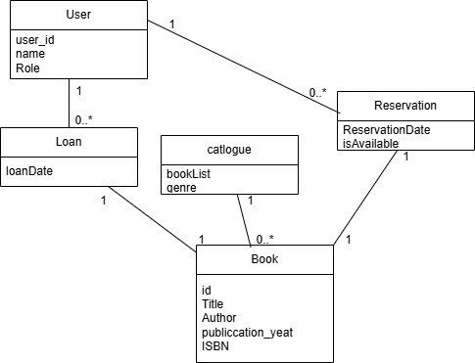
Domain Model

Slide 13
System sequence Diagrams

Slide 14
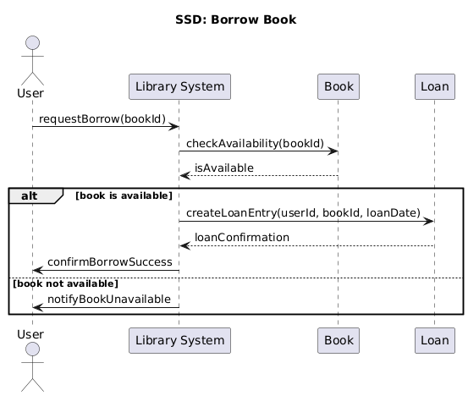
SSD: Borrow Book

Slide 15
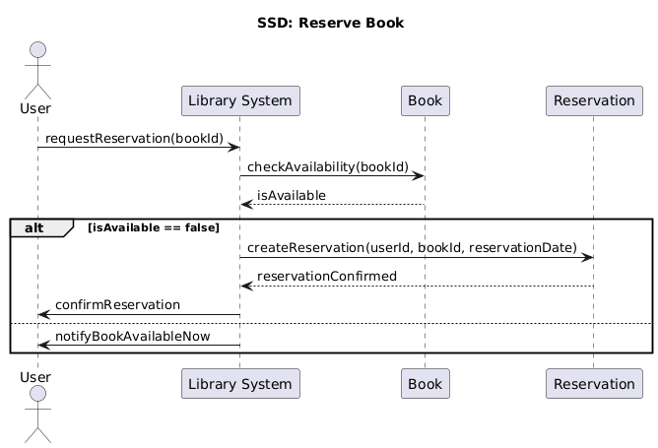
SSD: Reserve Book

Slide 16
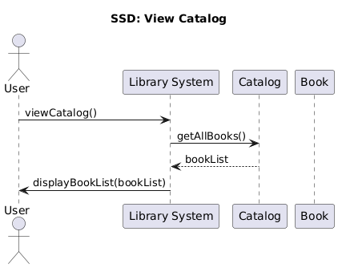
SSD: View Catalog

Slide 17
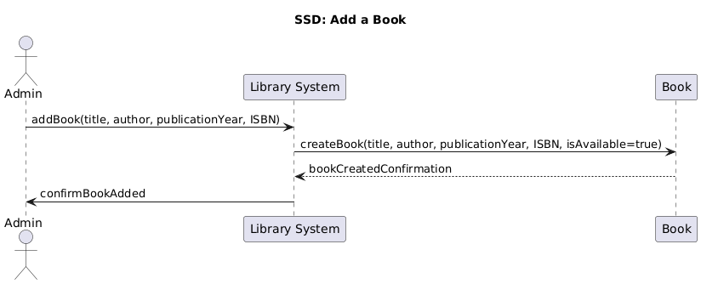
SSD: Add a Book

Slide 18
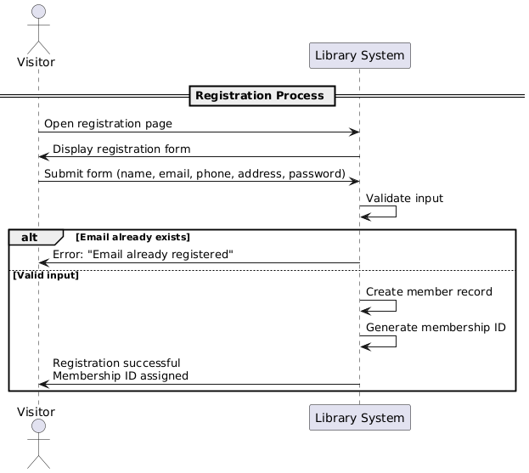
SSD: Add Member

Slide 19
Architecture of System

Slide 20
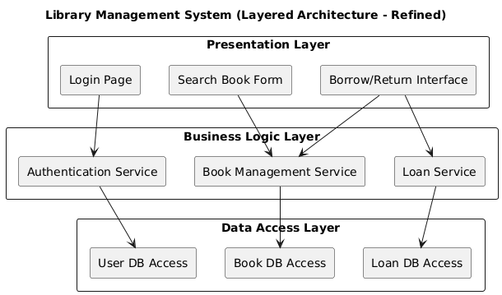
Layered Architecture

Slide 21
Architectural Proof of Concept
The Library Management System is designed using a 3-tier layered architecture. This structure promotes modularity, scalability, and separation of concerns, making the system easier to maintain and evolve.
Presentation Layer (User Interface)> Responsible for all user interactions — capturing input and displaying output.
Business Logic Layer (Application Layer)> Manages the system’s logic, coordinates use cases, enforces rules, and interacts with the database through the data access layer.
Data Access Layer (Persistence Layer)> Handles communication with the database; stores and retrieves information.

